Slide 1
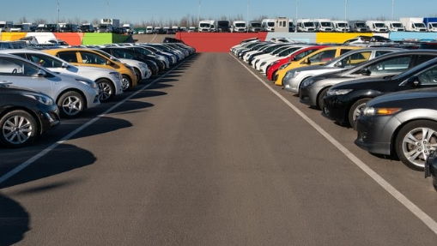
Lariat profit proposals
Created for Lariat board
Created by gilbert Hernandez

Slide 2
Agenda
Review Courses of Action (COA) to increase profit
Current Situation
Recommendation for immediate impact

Slide 3
Courses of action
COA 1: Change the fleet to capitalize on profitable vehicles.
COA 2: Maximize profit based on season.
COA 3: Compare revenue by branches and state.

Slide 4
Current situation 1 Profitable cars
Numerous cars are having a
negative impact on profit. If sold, Lariat can purchase a top revenue vehicle while maintaining or reducing expenses.

Slide 5
Current situation 2 Seasonal profits
Slight increase in price during the highest demand summer months would increase revenue.

Slide 6
Current situation 3 Revenue by state
Increase in branch locations in highest producing states could increase revenue.

Slide 7
Recommendation
For immediate revenue, increase rental price during peak season.
For sustained revenue, change fleet composition.
For long term revenue stream, expand by adding branches to highest demand states.

